Slide 1

Agentic Code Studio: AI Bug Detector and Optimizer
Team Merlin
Kishore B – CB.SC.U4AIE23139
Sai Charan M – CB.SC.U4AIE23143
Koushal Reddy M - CB.SC.U4AIE23145
Mohan Raj – CB.SC.U4AIE23147
Naveen Babu M S - CB.SC.U4AIE23153

Slide 2

Problem Statement
Problems in Traditional Software Development
Manual bug detection and fixing is repetitive and time-consuming.
Code optimization relies heavily on individual developer experience and seniority.
Security vulnerabilities are often detected too late (post-development).
Code reviews are inconsistent, subjective, and prone to human error.
Standard AI tools generate code but fail to validate executable correctness.
Need for Solution
Automated, self-correcting workflows for fixing, optimizing, and securing code.
Intelligent complexity analysis for algorithmic optimization.
Built-in security auditing during the coding phase.
Multi-agent collaboration to simulate a full engineering team.

Slide 3
Proposed Solution
Agentic Code Studio
An autonomous AI software engineering system
Uses multiple specialized AI agents
Automatically:
Detects bugs
Fixes errors
Optimizes performance
Audits security issues

Slide 4
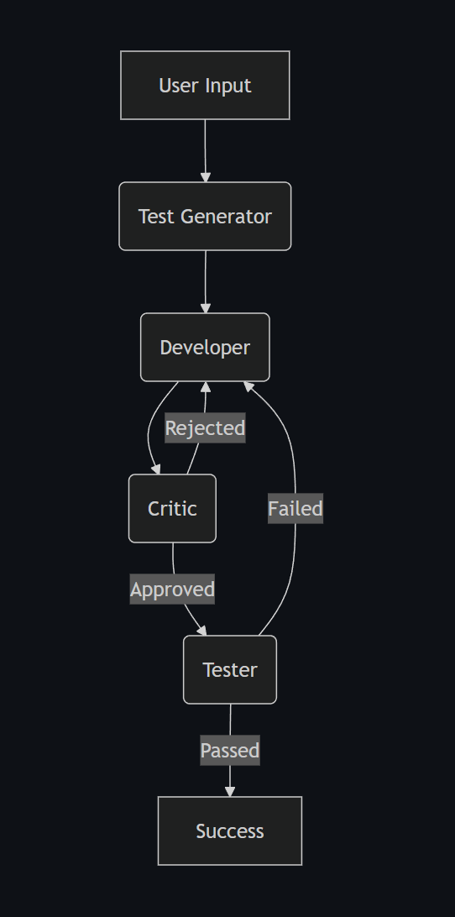
System Architecture

Slide 5
Multi-Agent Roles
Developer Agent
Writes and fixes code
Applies optimizations
Critic Agent
Reviews logic
Checks best practices
Finds design flaws
Tester Agent
Generates unit tests
Executes test cases
Confirms bug fixes
Security Agent
Detects vulnerabilities (SQL Injection, XSS, etc.)
Suggests secure patches

Slide 6

Key Features
Automated Bug Fixing
Iterative fix-review-test loop
Code Optimization
Improves time & space complexity
Refactors inefficient logic
Security Auditing
Static analysis for vulnerabilities
Secure coding recommendations
Modern UI
Interactive Next.js dashboard
Shows:
Agent decisions
Code diffs
Chat history

Slide 7

Technology Stack
Python
FastAPI
LangGraph
Google Gemini API
Next.js
Tailwind CSS

Slide 8
Project Workflow
User submits code
Test Driver automatically creates a script to run the code.
Developer agent proposes fixes
Critic agent reviews logic
Optimization workflow improves performance
Security workflow audits vulnerabilities
Final code is produced

Slide 9
Advantages
Reduces manual effort
Improves code quality
Faster debugging
Built-in security checks
Scalable and extensible

Slide 10
Applications
Software development teams
Code review automation
Secure application development
AI-assisted DevOps pipelines
Educational platforms

Slide 11
Future Enhancements
Support for more programming languages
Integration with GitHub pull requests
Real-time CI/CD automation
Advanced vulnerability detection
Cloud deployment

Slide 12
Conclusion
Agentic Code Studio automates core software engineering tasks
Multi-agent collaboration improves reliability
Reduces human effort and improves productivity
Represents the future of AI-assisted software development

Slide 13

THANK YOU

